Slide 1


SAP UI Development Toolkit for HTML5
SAPUI5 : Introduction
Diego Dora – Managing Director at sovanta AG & SAP Mentor

Slide 2

SAPUI5 : Introduction
About me
Managing Director at sovanta AG
12 years of experience with SAP Technologies
SAP Mentor
18 years of experience doing development
A life as a geek ☺

Slide 3
SAPUI5 : Introduction
Agenda
What’s SAPUI5?
What do I need to know?
What’s the Architecture?
End to End
MVC
Features
Enterprise Grade
UI Controls +180
Other libraries (D3.js / jQuery)
Why do I need to learn this?
Where do I start?

Slide 4
SAPUI5 : Introduction
What’s SAPUI5?
SAPUI5 is a Single Page Application framework.
Single-Page Applications framework allow us to create Apps that load a single HTML page and dynamically update that page as the user interacts with the app.
SPAs use JavaScript (AJAX: Asynchronous JavaScript And XML), CSS3 and HTML5 to create fluid and responsive Apps, without constant page reloads.
This means much of the work happens on the client side, in JavaScript.

Slide 5
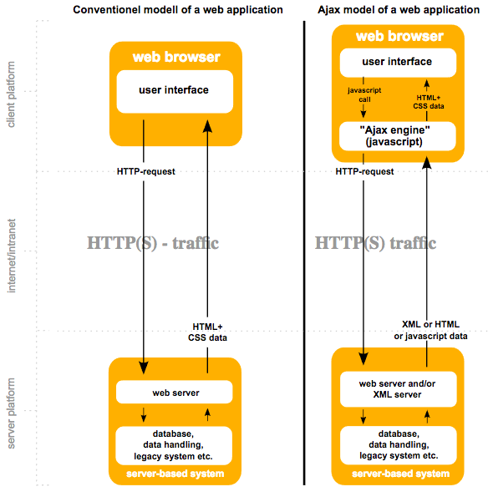
SAPUI5 : Introduction
What’s SAPUI5?

Slide 6
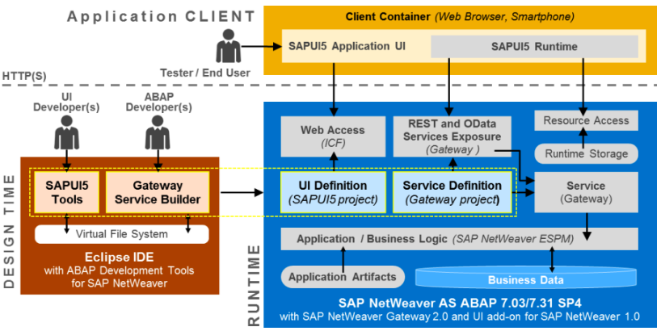
SAPUI5 : Introduction
End to End Architecture

Slide 7
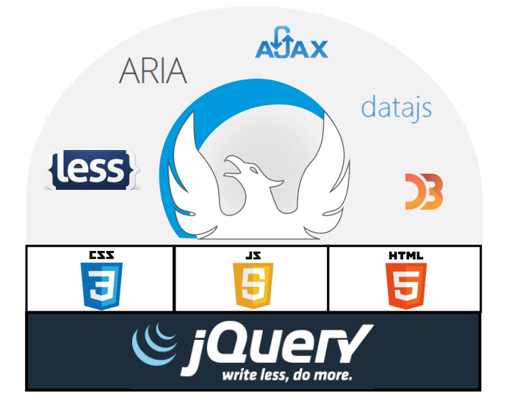
SAPUI5 : Introduction
What do I need to learn/know?
1st Tier
HTML5
Javascript
CSS3
MVC
2nd Tier
GIT
Task Runner (i.e.: GruntJS)
SAP BSP

Slide 8


SAPUI5 : Introduction
What do I need to learn/know?
Javascript
Created by Netscape Communications (1995)
Features:
High-level
Weakly typed
Object-based
Multi-paradigm
Interpreted
Originally created to be used on Client-Side Programming (browsers) for data validation and basic user interactions (pop-up).
Highly adopted by the development Community world wide and now also used on Server Side Programming (ex: NodeJS)

Slide 9
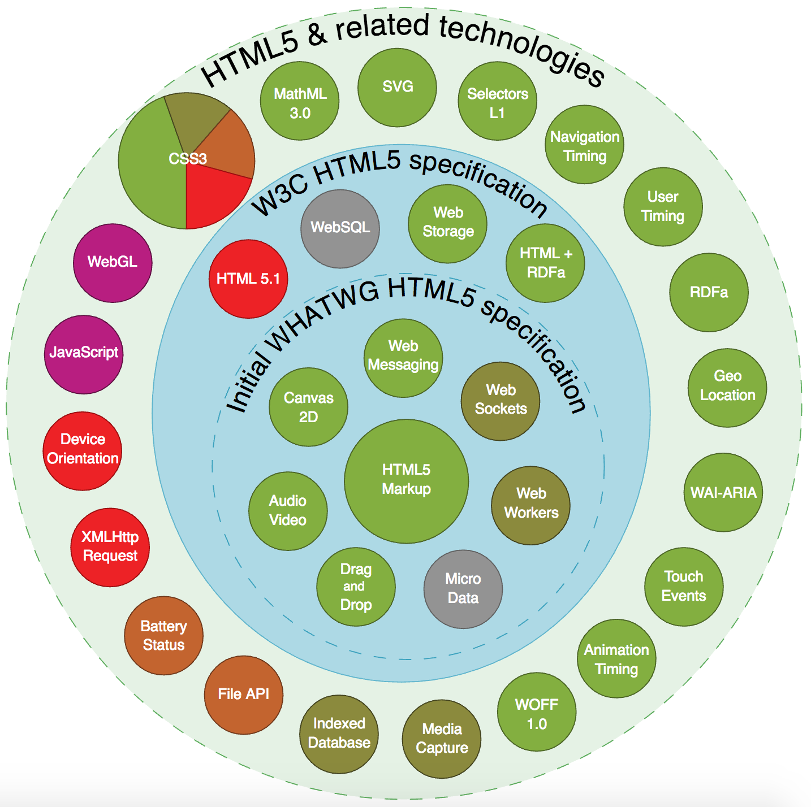
SAPUI5 : Introduction
What do I need to learn/know?
HTML5
Markup language for structuring and presenting content on the WWW.
Published in October 2014 by W3C.
Newest additions:
HTML Geolocation
HTML Drag and Drop
HTML Local Storage
HTML Application Cache
HTML Web Workers
HTML SSE

Slide 10
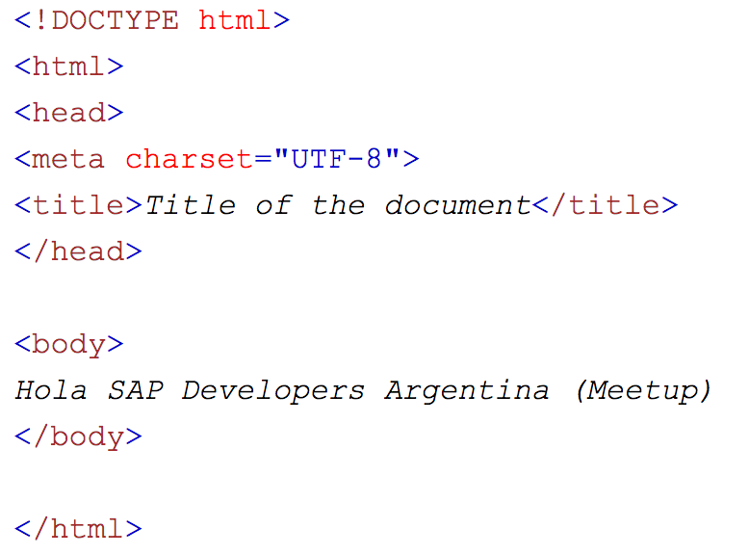
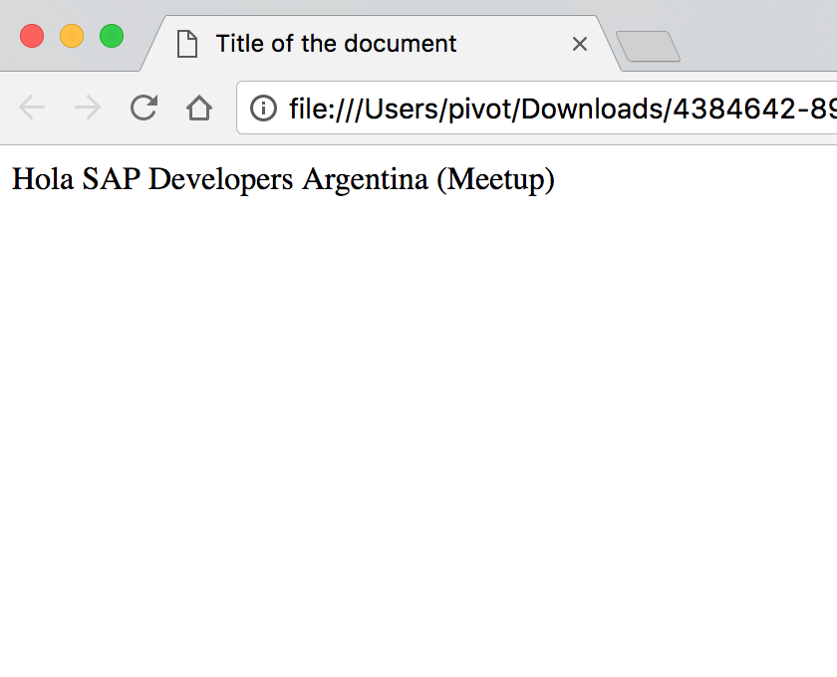
SAPUI5 : Introduction
What do I need to learn/know?

Slide 11
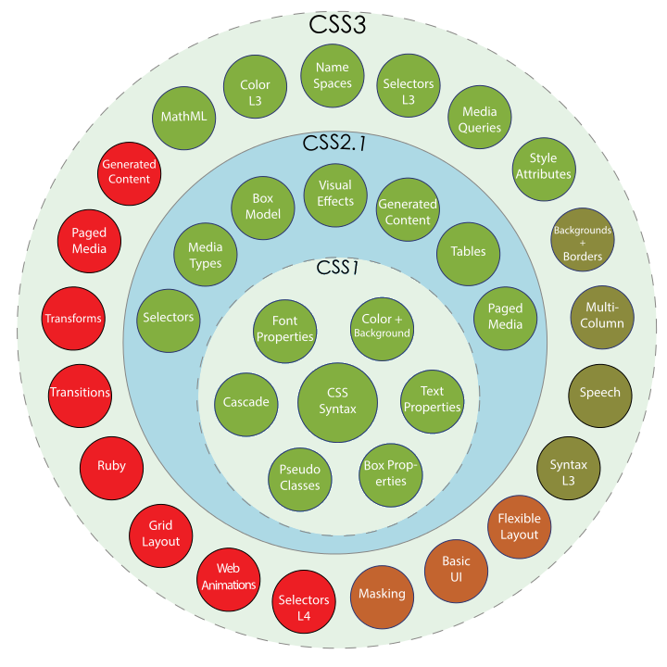
SAPUI5 : Introduction
What do I need to learn/know?
CSS3 (Cascade Style Sheets v3)
Used for describing the presentation of a document written in a markup language.
Utilization:
Layout
Colors
Fonts and Text
Backgrounds
Borders
Floats

Slide 12
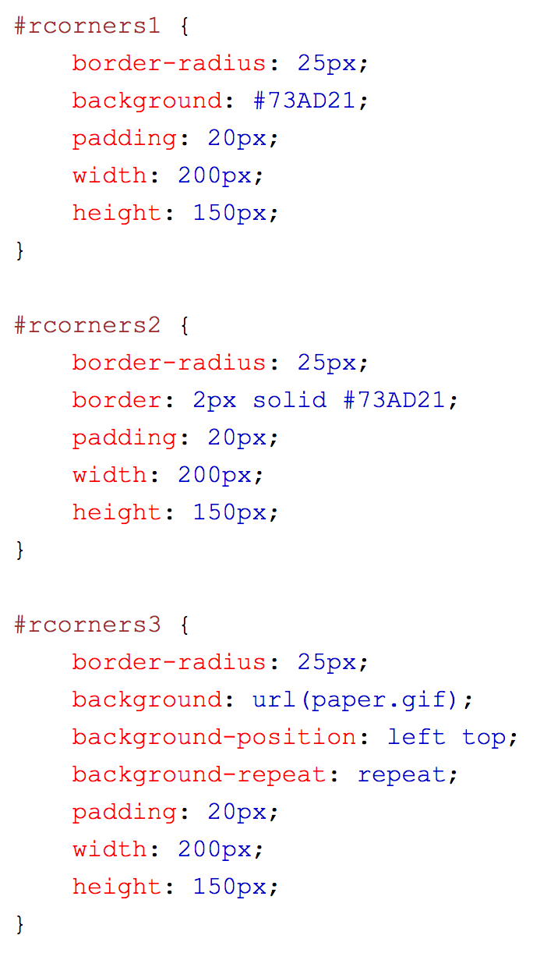
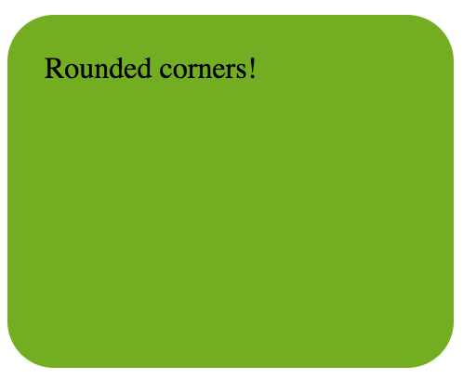
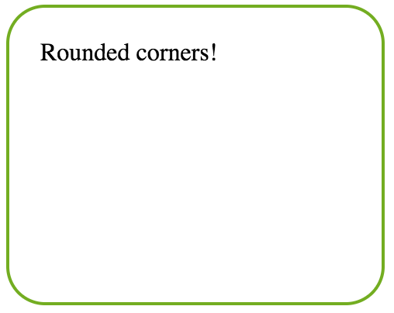
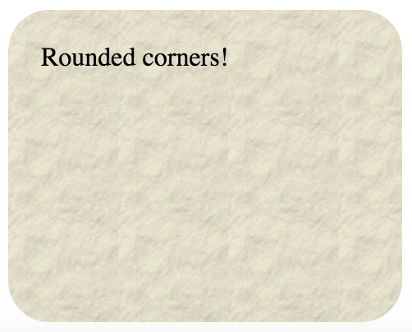
SAPUI5 : Introduction
What do I need to learn/know?

Slide 13
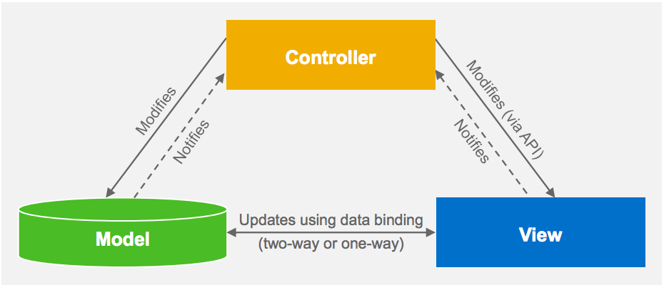
SAPUI5 : Introduction
What is Model View Controller (MVC)?
Three fundamental parts: Data (Model) + An interface to view and modify the data (View) + Operations to perform on the data (Controller)
More Info
The controller provides model data to the view, and interprets user actions such as button clicks. The controller depends on the view and the model.
The model represents the data (nothing else). The model does NOT depend on the controller or the view.
The view displays the model data, and sends user actions (e.g. button clicks) to the controller.

Slide 14
SAPUI5 : Introduction
Features
Enterprise-Grade
Extra quality assurance
Diagnostics (e.g. Ctrl-Alt-Shift-S popup)
Internationalization and right-to-left support
Accessibility
Extensibility
Theming

Slide 15
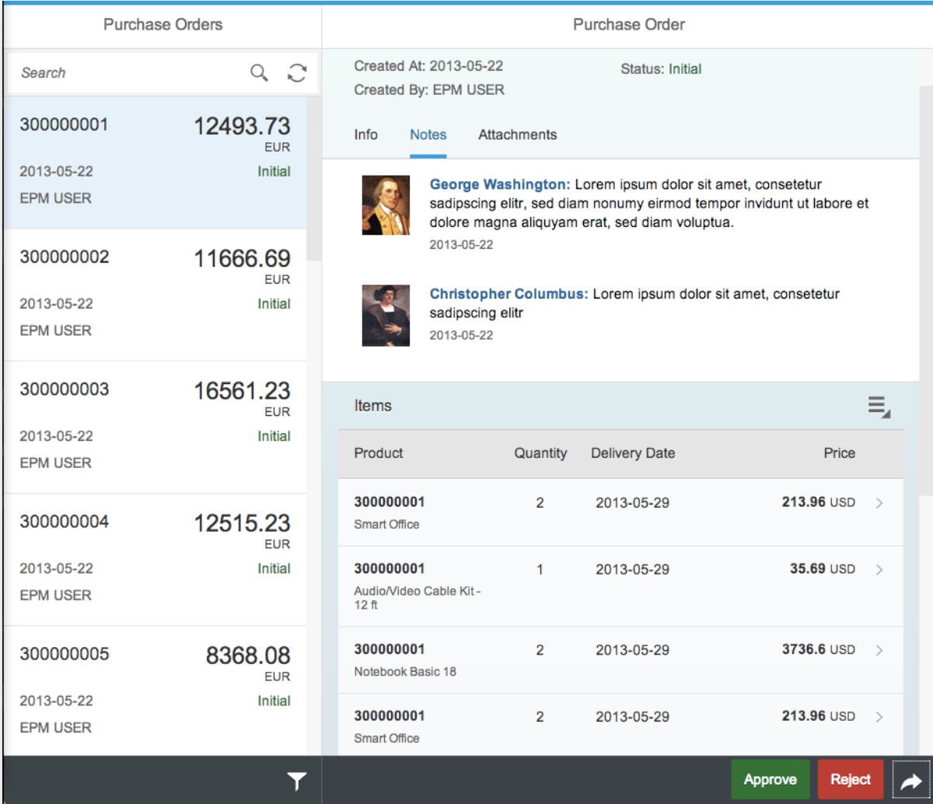
SAPUI5 : Introduction
Features
UI Controls (Out of the box)
UI5 provides 180+ UI elements
Buttons
Lists
Images
Tables
Text-Fields (e.g. Search)
Popups (Modals)
Date Picker
Etc.

Slide 16
SAPUI5 : Introduction
Features
Multiples Libraries
Data JS (Odata manipulation)
D3js (Data Driven Documents)
jQuery (DOM manipulation)
Qunit (unit testing)
+15 Third-party libraries

Slide 17
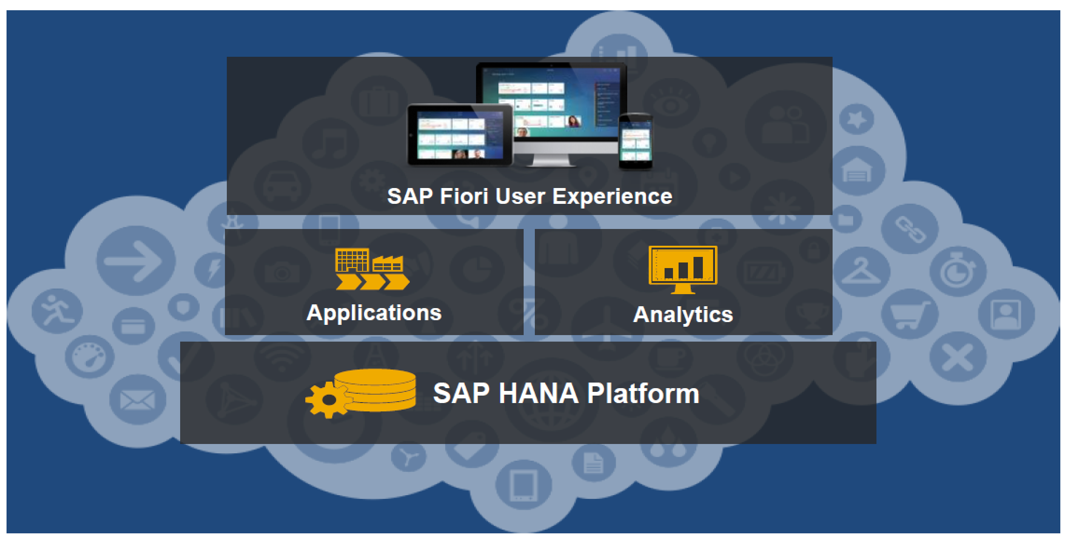
SAPUI5 : Introduction
Why do I need to learn this?

Slide 18
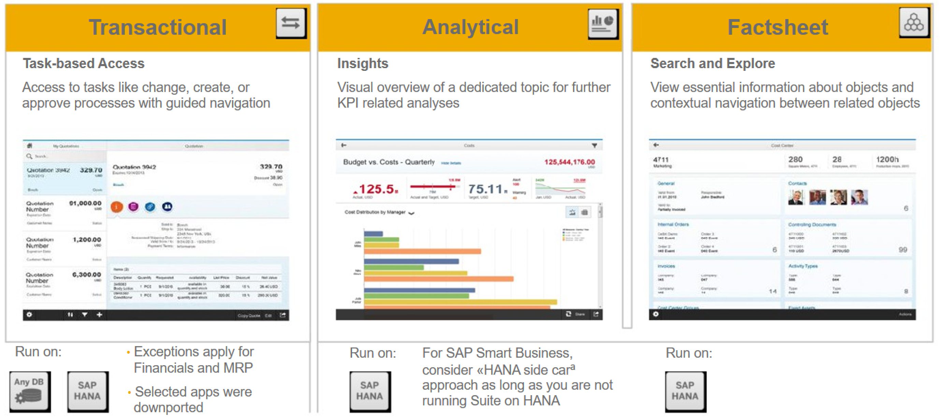
SAPUI5 : Introduction
Why do I need to learn this?

Slide 19
SAPUI5 : Introduction
Where do I start?
Resources
SAPUI5: https://open.sap.com/courses/ui51
SAPUI5 (Help/Tutorials): https://sapui5.hana.ondemand.com
W3C School : https://www.w3schools.com
OData : https://www.odata.org
Javascript: https://www.codecademy.com/learn/javascript
Where to Ask HTML5/JS/CSS3 Questions: www.stackoverflow.com
Slack: https://slackui5invite.herokuapp.com/
Books:
SAPUI5 (SAP Press) https://www.sap-press.com/sapui5_3980/
Javascript The Definitive Guide https://www.sap-press.com/sapui5_3980/

Slide 20
SAPUI5 : Introduction
Contact Info
Get in Touch
GitHub (Presentacion) : https://github.com/SAPDevelopersArgentina/1stMeetUp
Twitter: @diegohdora ( https://www.twitter.com/diegohdora )
@sitBuenosAires ( https://www.twitter.com/sitBuenosAires )
Facebook: /SAPDeveloperArgentina ( https://www.facebook.com/SAPDevelopersArgentina/ )
SCN: @diegohdora ( https://people.sap.com/diegohdora )
Website coming up: https://www.sit-buenosaires.com
Sigamos promoviendo COMUNIDAD en la región.

